Slide 1
Pokémon Nuzlockes Black and White 2
Preparation

Slide 2
Idea: Nuzlocking as object of reasearch
What is a Nuzlocke?
Blacking/Whiting out means losing the run
One catch per route (per Encounter Type)
No items in battle
No Overlevelling
Goal: show with data what makes Black and White 2 a hard nuzlocke challenge
Challenges:
Seasons, Challenge Mode
Irrelevant data on scraped sites

Slide 3
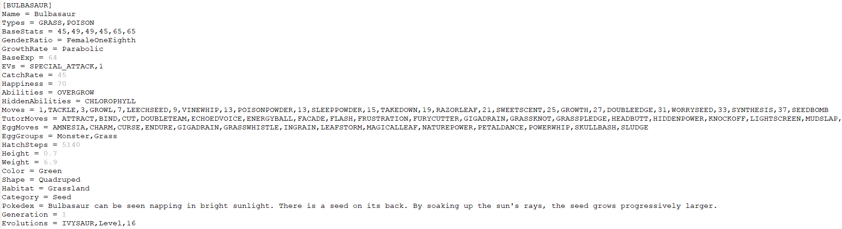
The Data
6 so-called PBS Files:
Pokémon, Forms, Abilities, Items, Moves, Types

Slide 4
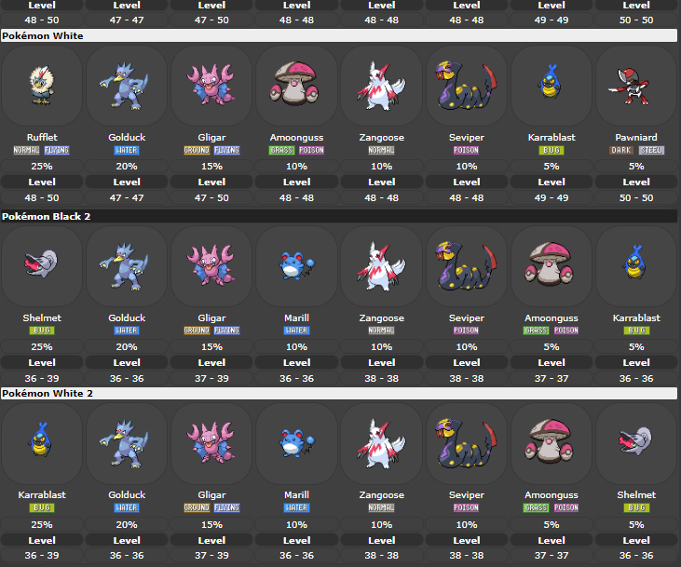
The Data
49 html files
Data on obtainable Pokémon, Items, etc.
Picture correlates to line 1583 in HTML file

Slide 5
Plans
Bring HTML files into usable format
Integrate all Data into Database
Establish “Challenge Ratings” for different parts of the game

Slide 6
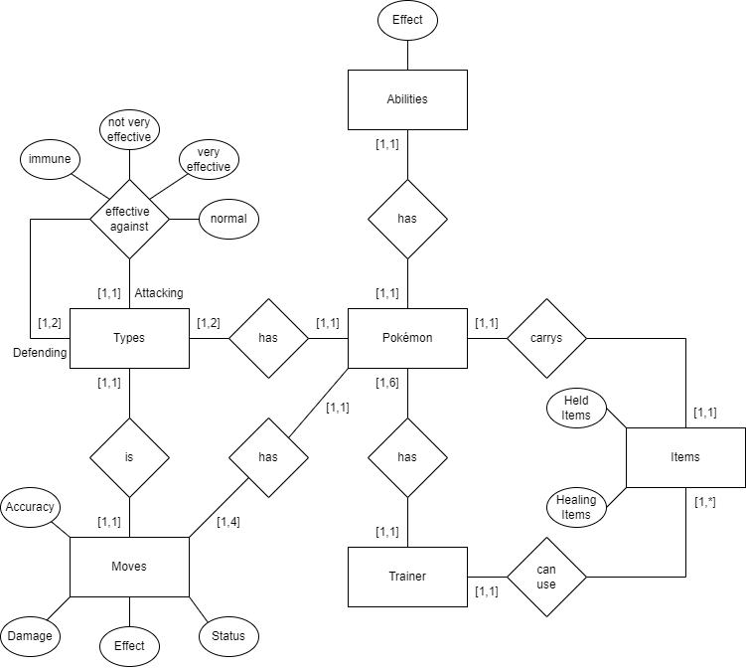
ER Model

Slide 7
Sources
Pokémon Essentials(https://www.mediafire.com/file/nbpd2yhgtp32883/, https://essentialsdocs.fandom.com/wiki/Essentials_Docs_Wiki)
Serebii.net(https://www.serebii.net/black2white2/)
Bulbapedia.net(https://bulbapedia.bulbagarden.net/wiki/Appendix:Black_2_and_White_2_walkthrough)

